Slide 1
DATA VISUALIZATIOn PROJECT
Covid-19 Issue: Slow vaccInatIon rate currently In turkey durIng covId 19 pandemIc.

Slide 2
Defınıtıon of the Issue
Since the covid 19 epidemic started, the vaccination rate in Turkey is very slow compared to other countries. In this research, I will examine the number of vaccinations made in Turkey so far and the ratio of this number to the population.

Slide 3
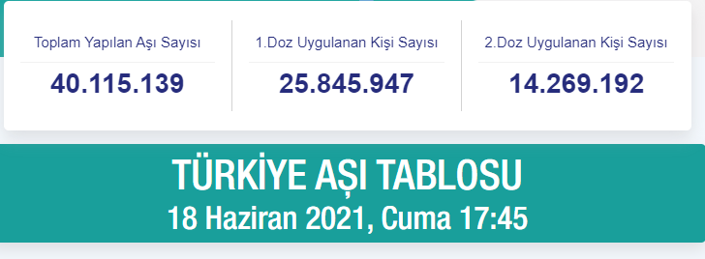
Data Informatıon
The first address I will apply to solve this problem is T.C. It is the official data sheet of the Ministry of Health. According to these data on 8 May 2021, the number of vaccines made so far in Turkey is 27,305,710. The number of people who received the 1st dose vaccine was 15.629.422, and the number of people who received the 2nd dose vaccine was 11.676.288. These data are precise information as they are in official and limited sources. According to the data of 18 June 2021, the number of vaccinations is as in the table on the right.

Slide 4
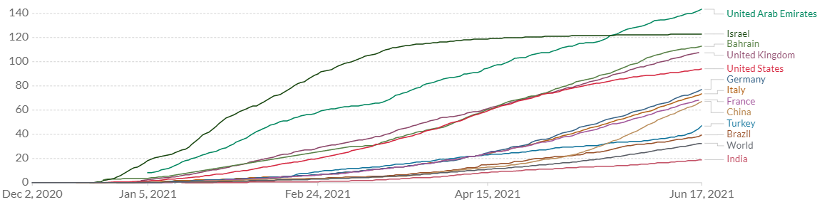
Vaccınatıon rate of Turkey compared to other countrıes
As of December, when the vaccination started, the vaccination chart of Turkey compared to the other 12 countries is as on the right. According to the chart, You can see that the vaccination rate in Turkey has increased very slowly in the last 5 months.

Slide 5
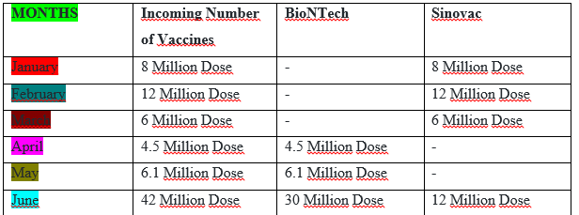
data on the rate of planned but not performed vaccınatıons
For herd immunity in Turkey, at least 120 million doses of vaccine must be administered within six months. However, the schedule for the expected 40.5 million doses of vaccine from China and how the remaining 80 million doses will be provided are unclear.
The Ministry of Health said that the first dose of vaccination in all age groups would be completed by June. But this did not happen due to slow vaccination.

Slide 6
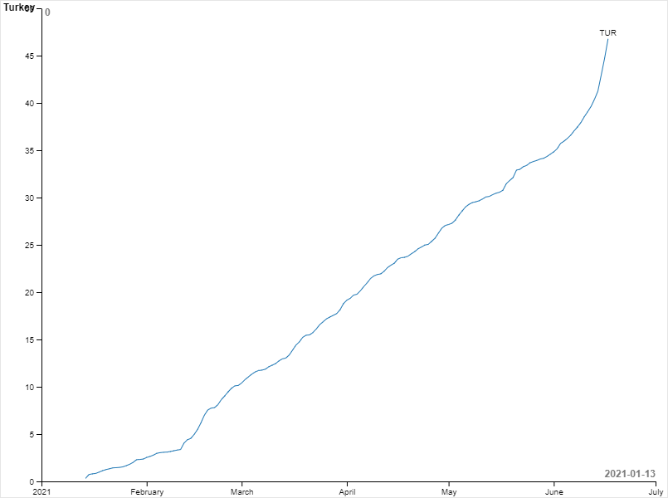
Graph of ıncrease ın vaccınatıon rate ın Turkey by months by percentage
In the graph on the side, I added the graph of the increase in the vaccination rate in Turkey by months.
I created this chart according to the data I researched and reached.

Slide 7
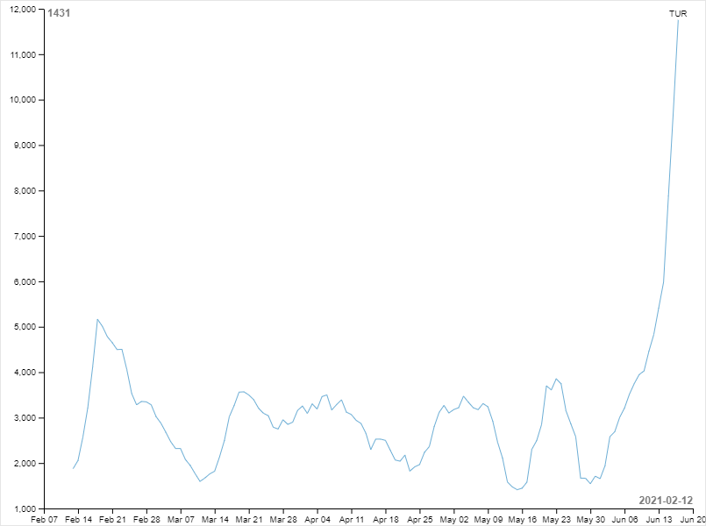
weekly number of vaccınatıons graph ın turkey
In this graph, you can see the weekly data on the number of vaccinations per 100 thousand people in Turkey.
As you can see in the graph, very low vaccination numbers are available until June.

Slide 8
Reasons for slow vaccınatıon ın Turkey
I can explain 3 reasons that cause slow vaccination in Turkey.
The first reason is that we are not a supplier of vaccines. We cannot produce vaccines, we are dependent on foreign countries (China and Germany) and we have to import them.
The second reason is economic conditions. The economic conditions in Turkey are not good and therefore we could not receive the vaccines that were planned to be taken or we received them too late.
The last reason is political movements. We sent the 10 million doses of vaccine we purchased to countries in need. (KKTC, Libya, Sudan)

Slide 9
The parts where I faced dıffıcultıes
First of all, due to the issue I wanted to investigate, I found very few datasets and could not use them in many programs or got errors. I tried to fix the errors I was getting and I tried hard to find suitable datasets. I could only find 2 datasets suitable for the location, and I tried to analyze as well as I could.
Public data on vaccination in Turkey was also very limited, so I faced many difficulties.

Slide 10
Thank you so much for listening…
16030411050
MIS
Sami Burak BULUT

